Slide 1




Tree Automata for Reasoning in Databases and Artificial Intelligence
Pierre Bourhis
CNRS CRIStAL, Equipe LINKS
Joint works with
M.Benedikt, M.Krötzsch, S. Rudolph, P. Senellart, M. Van Den Boom

Slide 2
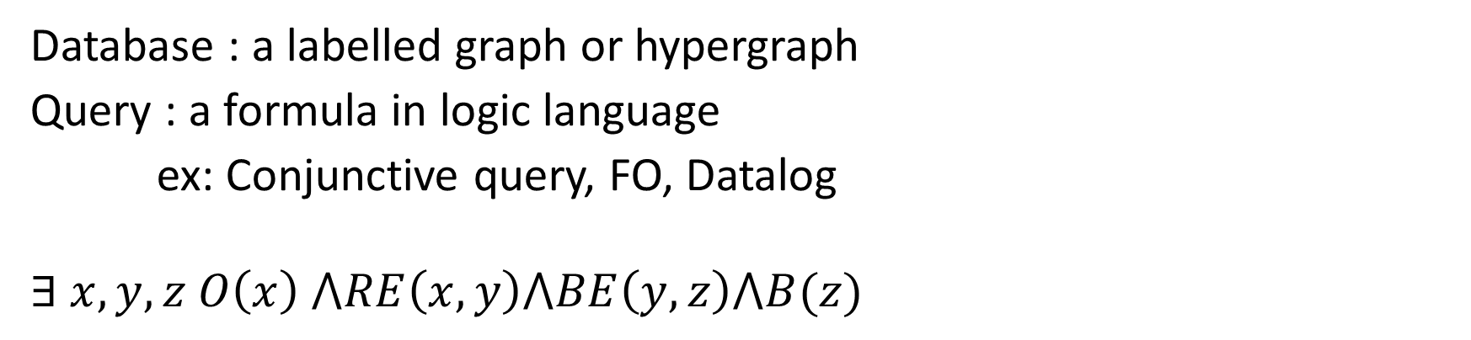
Querying a database
Database : a labelled graph or hypergraph
Query : a formula in logic language
ex: Conjunctive query, FO, Datalog
$$∃ x,y,z O\left(x\right) ⋀RE\left(x,y\right)⋀BE\left(y,z\right)⋀B(z)$$
a
b
c
x
y
z
d
e
f
g
h
i

Slide 3
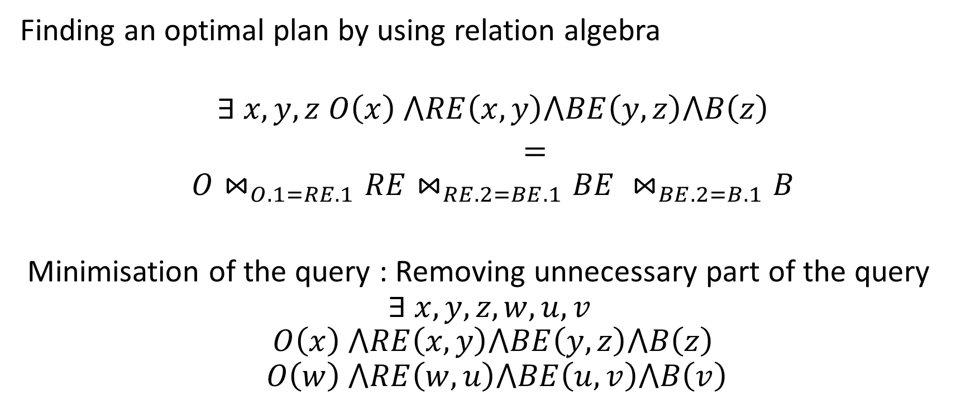
Optimisation of a query
Finding an optimal plan by using relation algebra
$$∃ x,y,z O\left(x\right) ⋀RE\left(x,y\right)⋀BE\left(y,z\right)⋀B\left(z\right)$$
=
$$O⋈_{O.1=RE.1}RE⋈_{RE.2=BE.1}BE ⋈_{BE.2=B.1}B$$
Minimisation of the query : Removing unnecessary part of the query
$$∃ x,y,z, w,u,v$$
$$O\left(x\right) ⋀RE\left(x,y\right)⋀BE\left(y,z\right)⋀B\left(z\right)$$
$$O\left(w\right) ⋀RE\left(w,u\right)⋀BE\left(u,v\right)⋀B\left(v\right)$$

Slide 4
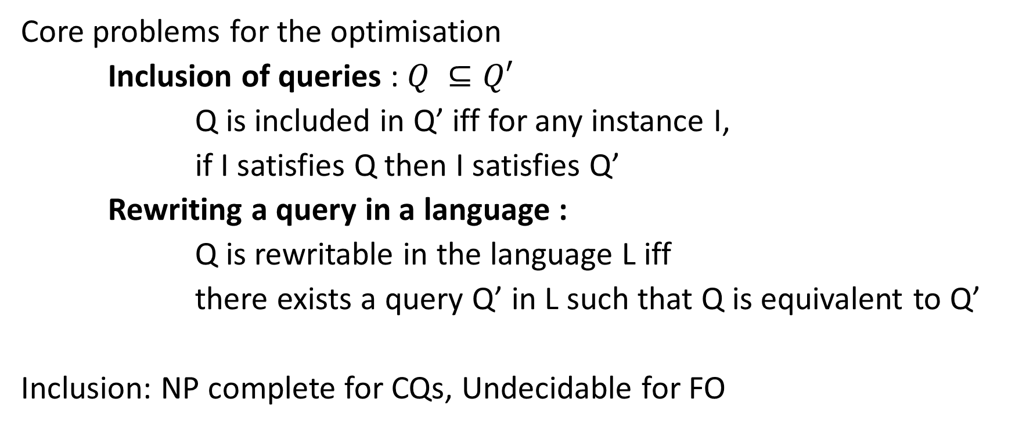
Optimisation of queries
Core problems for the optimisation
Inclusion of queries : $Q ⊆Q′$
Q is included in Q’ iff for any instance I,
if I satisfies Q then I satisfies Q’
Rewriting a query in a language :
Q is rewritable in the language L iff
there exists a query Q’ in L such that Q is equivalent to Q’
Inclusion: NP complete for CQs, Undecidable for FO

Slide 5
Data on the Web
Exchange of data : XML = Trees, Queries based on Tree automata
Diffusion of Data : RDF
Labelled Graph
SPARQL : SQL-Lite Languages with new features
(OPTIONNAL)
Path Properties x.L.y: Is there exists a path between x and y that satisfies L (regular language) ?
Inference of information : Incomplete Data and rules to infer new facts

Slide 6

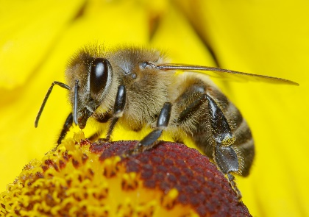



Example
$$Subtype\left(x,y\right)⋀Suclasse\left(y,z\right)→Subtype\left(x,z\right)$$
$$Subclasse\left(x,y\right)∧Subclasse\left(y,z\right)→Suclasse(x,z)$$
SubType
SubType
Bee
Hymemoptera
Insect
SubType
SubClassOf
SubClassOf
SubClassOf
SubType
Animal

Slide 7
Datalog
Program
A set of extentional relations : VSubclass
A set of intentional relations : SubClassOf
Rules = Horn Clauses
VSubclass(x,z) :- Subclass(x,z)
VSubclass(x,z) : VSubclass(x,y), Vsubclass(y,z)
Semantics : Least Fixpoint
Query over the intentional and extentional relations

Slide 8

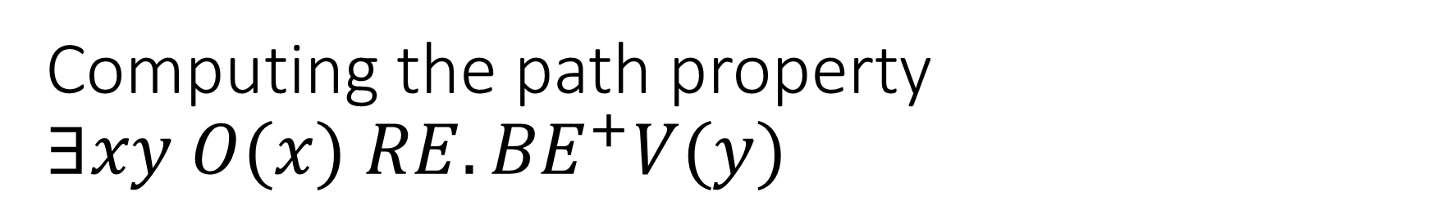



Computing the path property $∃xy O(x) {RE.BE}^{+}V(y)$
Program
q1(x) :- O(x),RE
q2(x) :- q1(y), RE(y,x)
q3(x) :- q2(y), BE(y,x)
q3(x) :- q3(y), BE(y,x)
Query: $∃ x q3(x)∧V(x)$
$$RE$$
$$BE$$
$$BE$$
q1
q2
q3

Slide 9
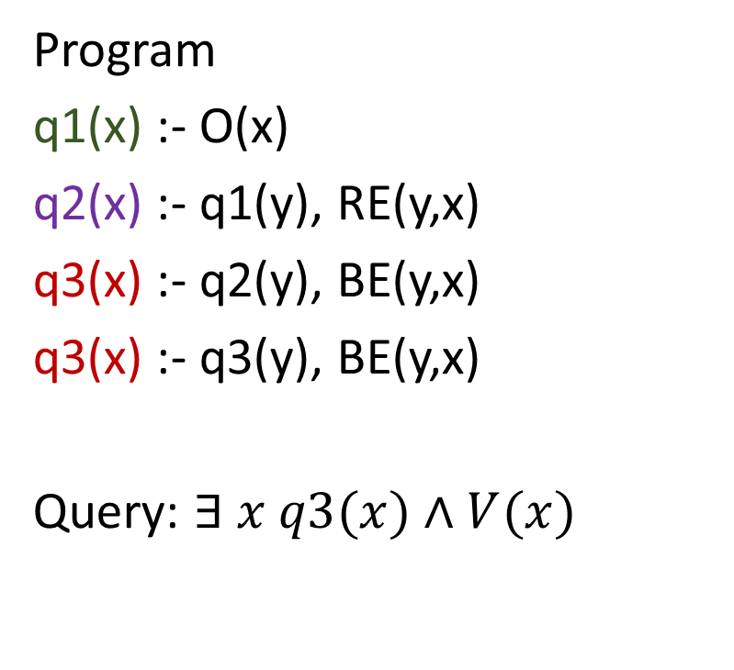
Evaluation of the Datalog program
Program
q1(x) :- O(x)
q2(x) :- q1(y), RE(y,x)
q3(x) :- q2(y), BE(y,x)
q3(x) :- q3(y), BE(y,x)
Query: $∃ x q3(x)∧V(x)$
a
b
c
d
e
f
g
h
i

Slide 10
Optimisation de Datalog
Difficulty: No notion of static plans
Rewriting for deriving only useful facts
Minimisation : Removing unnecessary rules
Inclusion of Datalog programs is undecidable
Inclusion is decidable for sublanguages
Rewriting in FO is undecidable for Datalog but decidable for sublanguages

Slide 11
Inclusion for Datalog program
Classical Sublanguages:
Monadic Datalog: only unary intentional relations
frontier Guarded Datalog: all the variables in the head atom appear in one atom in the body
VSubclass(x,z) :- Subclass(x,z)
VSubclass(x,z) : VSubclass(x,y), Vsubclass(y,z)
Monadic Datalog Containment and FO Rewritability is 2EXPTIME-C
[Cosmadakis & al 1988, Benedikt & al 2012]
Guarded Datalog Containment and FO Rewritability is 2EXPTIME-C
[Barany & al 2012]

Slide 12
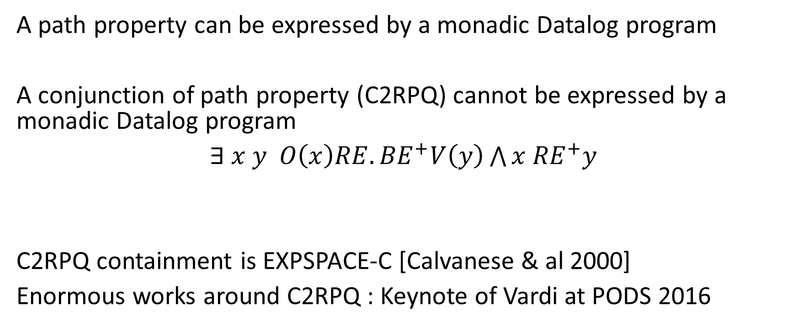
Datalog and Path Properties
A path property can be expressed by a monadic Datalog program
A conjunction of path property (C2RPQ) cannot be expressed by a monadic Datalog program
$∃ x y O\left(x\right){RE.BE}^{+}V\left(y\right)\bigwedge{x {RE}^{+}y}$
C2RPQ containment is EXPSPACE-C [Calvanese & al 2000]
Enormous works around C2RPQ : Keynote of Vardi at PODS 2016

Slide 13
Generalisation of Monadic/Guarded Datalog: MQ/ GQ
Adding a set of global variables α, β … to the rules.
Evaluation:
  Assign a value to each global variable
  Rewrite the program by using this assignment
  Evaluate classically the obtained Datalog program
For each MQ, there is an equivalent Datalog program

Slide 14
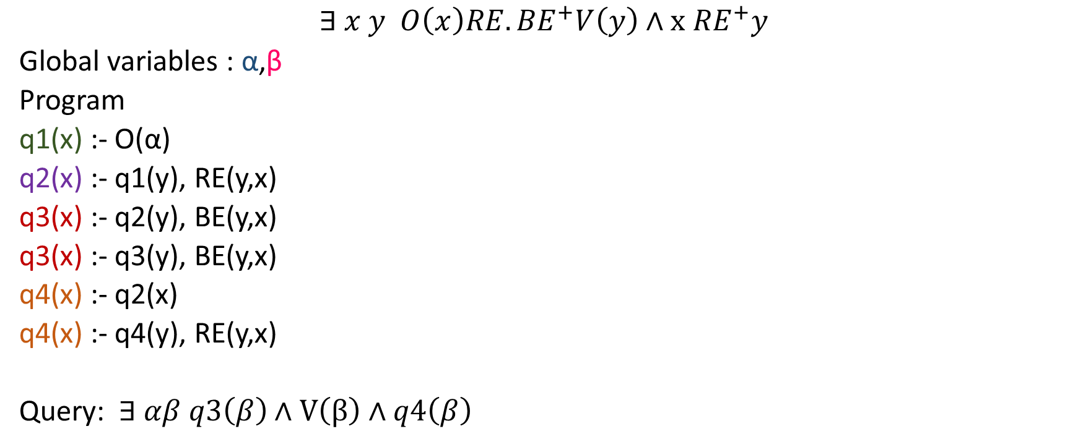
Example
$$∃ x y O\left(x\right){RE.BE}^{+}V\left(y\right)∧x {RE}^{+}y$$
Global variables : α,β
Program
q1(x) :- O(α)
q2(x) :- q1(y), RE(y,x)
q3(x) :- q2(y), BE(y,x)
q3(x) :- q3(y), BE(y,x)
q4(x) :- q2(x)
q4(x) :- q4(y), RE(y,x)
Query: $∃ αβ q3\left(β\right)∧V\left(β\right)∧q4\left(β\right)$

Slide 15
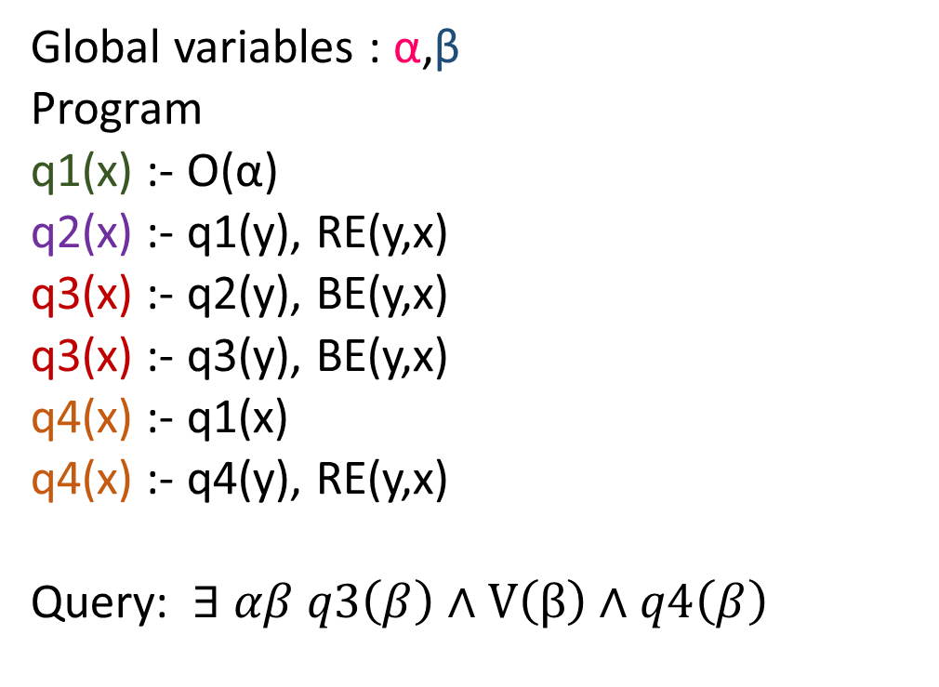
Evaluation of the example
Global variables : α,β
Program
q1(x) :- O(α)
q2(x) :- q1(y), RE(y,x)
q3(x) :- q2(y), BE(y,x)
q3(x) :- q3(y), BE(y,x)
q4(x) :- q1(x)
q4(x) :- q4(y), RE(y,x)
Query: $∃ αβ q3\left(β\right)∧V\left(β\right)∧q4\left(β\right)$
a
b
c
d
e
f
g
h
i

Slide 16
Optimisation of MQ/GQ
Inclusion of Datalog in GQ is 3Exptime-C [Bourhis & al 2015]
Rewritability of GQ in FO is decidable [Benedikt & al 2016]
Generalization of k-nested GQ : the output of GQ is used as a relation in another GQ.
Inclusion of Datalog in is k+2 Exptime-complete [Bourhis & al 2015]
Rewritability of GQ^{k} in FO is decidable [Benedikt & al 2016]

Slide 17
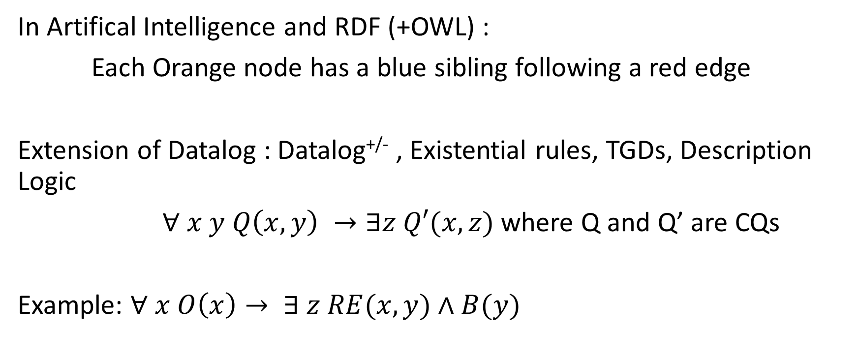
Datalog not sufficient for general reasoning
In Artifical Intelligence and RDF (+OWL) :
Each Orange node has a blue sibling following a red edge
Extension of Datalog : Datalog^{+/-} , Existential rules, TGDs, Description Logic
$∀ x y Q\left(x,y\right) →∃z Q′(x,z)$ where Q and Q’ are CQs
Example: $∀ x O\left(x\right)→ ∃ z RE(x,y)∧B(y)$

Slide 18


Reasonning with TGDs
C be a set of rules; Q be a query; I be an instance
I certainly satisfies Q for C iff for each J s.t J includes I and satisfies C then J satisfies Q
J J J J
I
$$⊨Q$$
I
$$⊨C$$

Slide 19
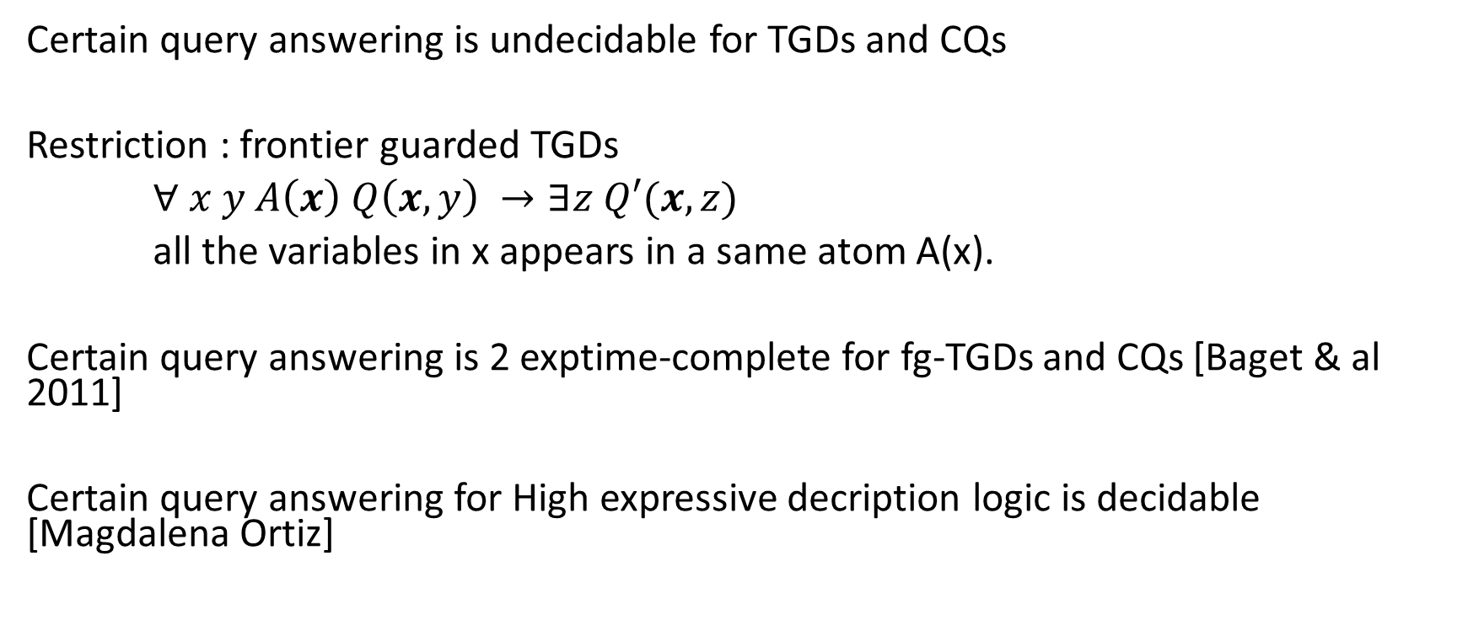
Some results on reasoning
Certain query answering is undecidable for TGDs and CQs
Restriction : frontier guarded TGDs
$∀ x y A\left(x\right) Q\left(x,y\right) →∃z Q′(x,z)$
all the variables in x appears in a same atom A(x).
Certain query answering is 2 exptime-complete for fg-TGDs and CQs [Baget & al 2011]
Certain query answering for High expressive decription logic is decidable [Magdalena Ortiz]

Slide 20
Common Idea to prove these results
The schema of the proof :
Showing that there exists k such that
If there exists a witness that
    Satisfies Q
    Does not satisfy Q’
Then there exists a witness satisfying 1 and 2
and that has treewidth bounded by k.

Slide 21
Bounded Treewidth
Tree decomposition of an instance I
A set of bags of values covering the instance associated with a child relation such that
  The child relation is a tree structure
  For each fact f, there exists a bag such containing all the values in f
  For two bags b1 and b2 containing the same value, then all bags on the path between b1 and b2 contain this value
Tree width of an instance = minimal size of the bags used in a covering
From a tree decomposition, code the instance in a tree encoding :
A tree over an finite alphabet with two functions of coding and decoding
decoding(coding(I)) is isomorphic to I

Slide 22
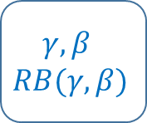
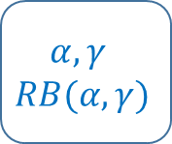
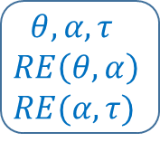
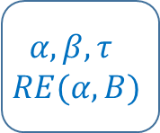
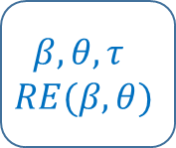
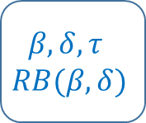
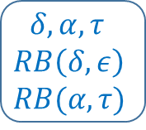
Example
$$α,β,τ$$
$$RE(α,B)$$
a,b,i
a
b
c
$$α,γ$$
$$RB(α,γ)$$
$$β,θ,τ$$
$$RE(β,θ)$$
$$β,δ,τ$$
$$RB(β,δ)$$
a,d
b,i,e
b,i,c
d
e
f
g
h
i
$$γ,β$$
$$RB(γ,β)$$
$$θ,α,τ$$
$$RE\left(θ,α\right)$$
$$RE(α,τ)$$
$$δ,α,τ$$
$$RB\left(δ,ε\right)$$
$$RB(α,τ)$$
d,g
i,e,h
i,c,f
Instance
Tree Decomposition
Tree encoding

Slide 23
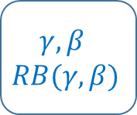




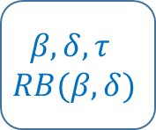

Important properties of tree encoding
Letter: pair set of symbols and a set of facts over these symbols
Tree encoding over a finite alphabet which size depends only on the tree width of I
A symbol appears in labels of two consecutive nodes iff it represents the same value in the instance
$$α,β,τ$$
$$RE(α,B)$$
$$α,γ$$
$$RB(α,γ)$$
$$β,θ,τ$$
$$RE(β,θ)$$
$$β,δ,τ$$
$$RB(β,δ)$$
$$γ,β$$
$$RB(γ,β)$$
$$θ,α,τ$$
$$RE\left(θ,α\right)$$
$$RE(α,τ)$$
$$δ,α,τ$$
$$RB\left(δ,ε\right)$$
$$RB(α,τ)$$
Tree encoding

Slide 24
Common Idea to prove these results
The schema of the proof :
Witness of Q and not Q’ has tree width less than k
Sufficient set of witness of Q with tree width less than k is regular
Q’ can rewritten by in a MSO formula
Courcell Theorems ensure that the problem of containment is decidable
For Datalog subclasses : Finite Trees
For TGDs subclasses : Infinite Trees

Slide 25
Application to Datalog

Slide 26

Proving the regularity of the witnesses
General Idea: Proof Tree [Chaundhuri & Vardi 1995]
Program
q1(x) :- O(x)
q2(x) :- q1(y), RE(y,x)
q3(x) :- q2(y), BE(y,x)
q3(x) :- q3(y), BE(y,x)
Query: $∃ x q3(x)∧V(x)$
Instance
q3(i) , V(i)
q3(x) , V(x)
q3(i) :- Q2(f), BE(f,i)
q3(x) :- q2(y), BE(y,x)
q3(f) :- Q2(c), BE(c,f)
q3(z) :- q2(z), BE(z,y)
q3(c) :- Q2(b), BE(b,c)
q3(y) :- q2(w), BE(w,y)
a
b
c
q2(b) :- Q1(a), RE(a,b)
q2(u) :- q1(u), RE(u,w)
d
e
f
q1(a) :- O(a)
q1(u) :- O(u)
g
h
i
Proof Tree
Unfolding

Slide 27
Proving the regularity
Unfoldings sufficient for the witnessing Q and not Q’ because Q’ is homomorphic closed
Unfolding of Datalog Program has bounded treewidth
The maximal number of variables in a rule
The set of tree encodings obtained from unfoldings is regular
The size of the alphabet is exponential in the Datalog Program
The size of the automata is exponential in the Datalog Program

Slide 28
Improving the complexity
Translating Monadic Datalog in MSO over the instance
Translating MSO over the instance in MSO over the tree encoding (Courcelle)
Translating MSO in tree automata
Non elementary bound
Goal: obtaining a better bound

Slide 29
Translating a rule into a top down tree automata
A rule selects a value
Ranked Trees with a relation S showing which value is returned
It appears only once in the tree
State:
  partial mapping of the variables into the symbol of the current letter
  Subquery satisfied in the current letter
    Intentional predicates guessed into the current letter
  Subquery still not satisfied
Transition : Updating the partial mapping by guessing it

Slide 30



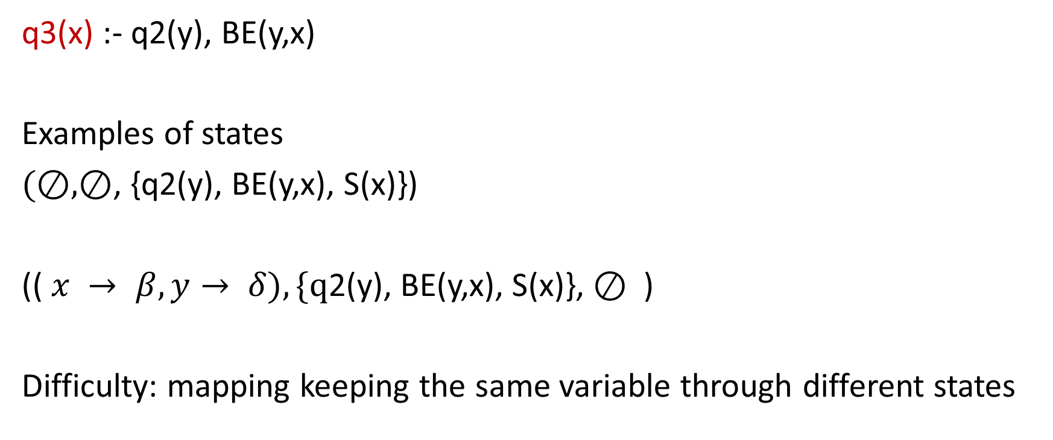
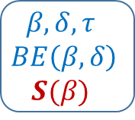
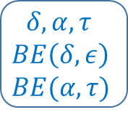


Translating a rule into a bottom up tree automata
$$α,β,τ$$
$$RE(α,B)$$
q3(x) :- q2(y), BE(y,x)
Examples of states
$(⊘,⊘$, {q2(y), BE(y,x), S(x)})
(( $x → β, y→ δ), \{q$2(y), BE(y,x), S(x)}, $⊘$ )
Difficulty: mapping keeping the same variable through different states
$$α,γ$$
$$RB(α,γ)$$
$$β,θ,τ$$
$$RE(β,θ)$$
$$β,δ,τ$$
$$BE\left(β,δ\right)$$
$$S(β)$$
$$γ,β$$
$$RB(γ,β)$$
$$θ,α,τ$$
$$RE\left(θ,α\right)$$
$$RE(α,τ)$$
$$δ,α,τ$$
$$BE\left(δ,ε\right)$$
$$BE(α,τ)$$

Slide 31
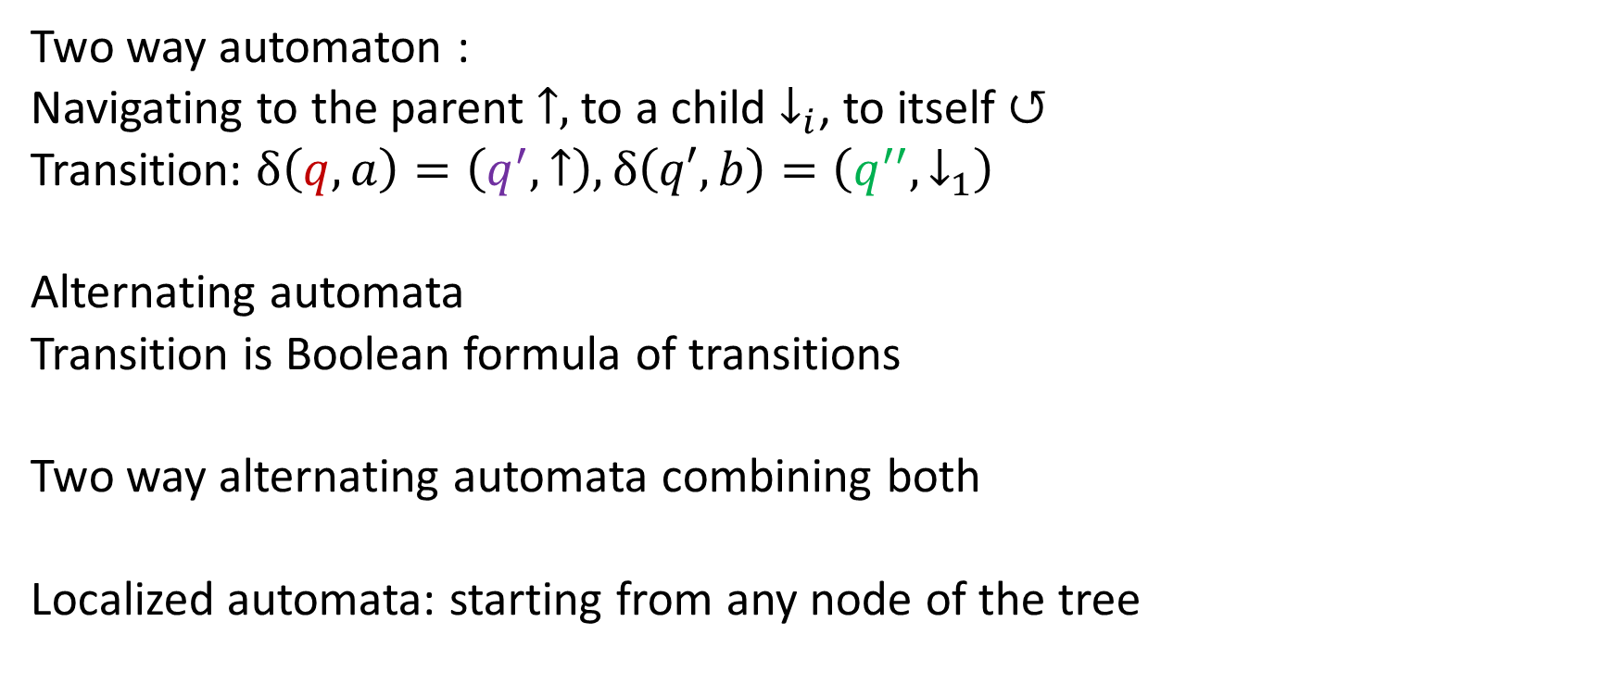
From Tree automata to Localized automata
Two way automaton :
Navigating to the parent $↑,$ to a child $↓_{i}$, to itself $↺$
Transition: $δ\left(q,a\right)=\left(q^{′},↑\right),δ\left(q′,b\right)=\left(q^{′′},↓_{1}\right)$
Alternating automata
Transition is Boolean formula of transitions
Two way alternating automata combining both
Localized automata: starting from any node of the tree
b
a
g

Slide 32
From Tree automata to Localized automata
Goal: removing S
Intuitive idea:
The node where a localised automata starts from
=
the node labelled S in our tree
For any top down automata selecting a node, there exists an equivalent localized automata starting from the selected node

Slide 33



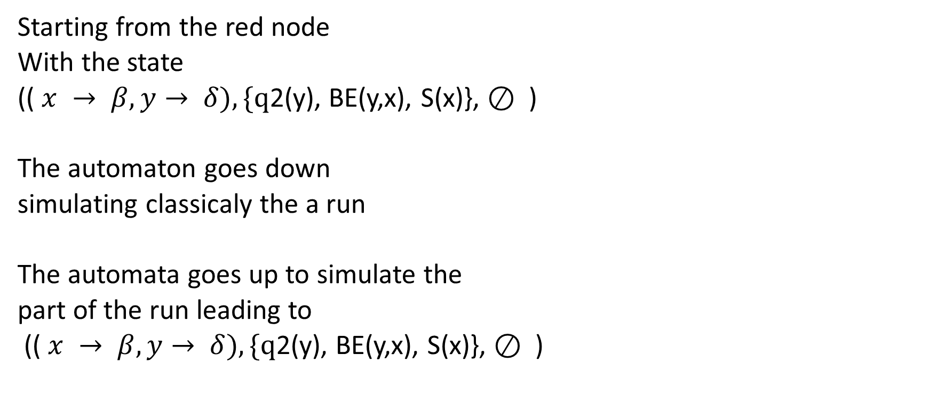




From Tree automata to localized automata
Starting from the red node
With the state
(( $x → β, y→ δ), \{q$2(y), BE(y,x), S(x)}, $⊘$ )
The automaton goes down
simulating classicaly the a run
The automata goes up to simulate the
part of the run leading to
(( $x → β, y→ δ), \{q$2(y), BE(y,x), S(x)}, $⊘$ )
$$α,β,τ$$
$$RE(α,B)$$
$$α,γ$$
$$RB(α,γ)$$
$$β,θ,τ$$
$$RE(β,θ)$$
$$β,δ,τ$$
$$BE\left(β,δ\right)$$
$$γ,β$$
$$RB(γ,β)$$
$$θ,α,τ$$
$$RE\left(θ,α\right)$$
$$RE(α,τ)$$
$$δ,α,τ$$
$$BE\left(δ,ε\right)$$
$$BE(α,τ)$$

Slide 34
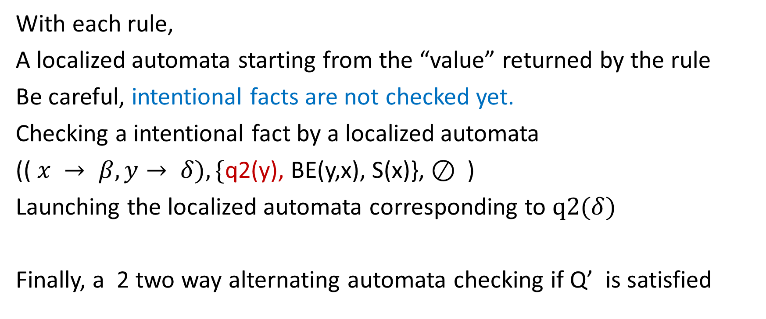
Combining the automata for each rule
With each rule,
A localized automata starting from the “value” returned by the rule
Be careful, intentional facts are not checked yet.
Checking a intentional fact by a localized automata
(( $x → β, y→ δ), \{$q2(y), BE(y,x), S(x)}, $⊘$ )
Launching the localized automata corresponding to $q2(δ)$
Finally, a 2 two way alternating automata checking if Q’ is satisfied

Slide 35
Finishing the proof
A tree automaton describing the tree encoding of the unfoldings of Q.
Its size is exponential in Q
A two alternating automaton describing the tree encodings of instances satisfying Q’. Its size is exponential in Q’ and Q.
Following Cosmadakis & al 1988, there exists a two alternating automata for not Q’ which size is exponential in Q’.
Therefore there exists a tree automata describing not Q’ of size 2 exponential for Q’
The emptiness of the intersection of 2 tree automata is in ptime in their size.

Slide 36
To MQ
Generalization for MQ:
Problem : a set of global variables.
Consider trees with valuation of the global variables represented by using new relations appearing once in a tree
Translating the MDL program using previous method for such trees.
Pb: Not the possibility to negate the two way alternating automata to obtain not Q’.
Solution: first translating in a tree automata then projecting the relations representing the global variables and then complementing
-> Exponential blow up

Slide 37
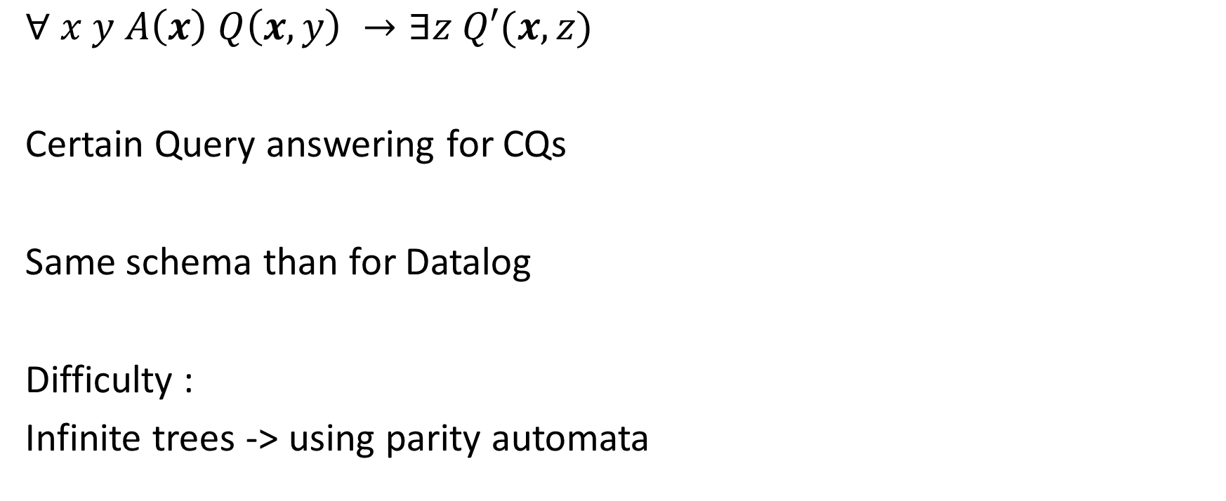
For frontier guarded TGDs
$∀ x y A\left(x\right) Q\left(x,y\right) →∃z Q′(x,z)$
Certain Query answering for CQs
Same schema than for Datalog
Difficulty :
Infinite trees -> using parity automata

Slide 38
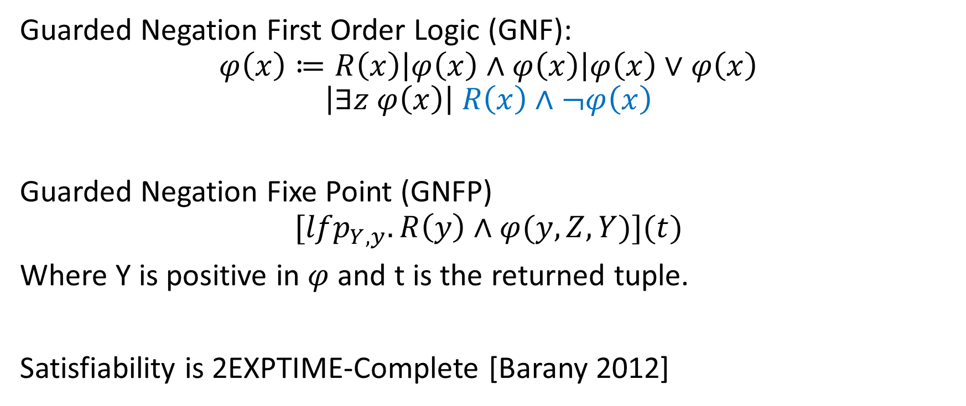
Generalization to Logics
Guarded Negation First Order Logic (GNF):
$$φ\left(x\right)≔R\left(x\right)\left|φ\left(x\right)∧φ\left(x\right)\right|φ\left(x\right)∨φ\left(x\right)$$
$$\left|∃z φ\left(x\right)\right| R\left(x\right)∧¬φ\left(x\right)$$
Guarded Negation Fixe Point (GNFP)
$${[lfp}_{Y,y}. R\left(y\right)∧φ(y,Z,Y)](t)$$
Where Y is positive in $φ$ and t is the returned tuple.
Satisfiability is 2EXPTIME-Complete [Barany 2012]

Slide 39
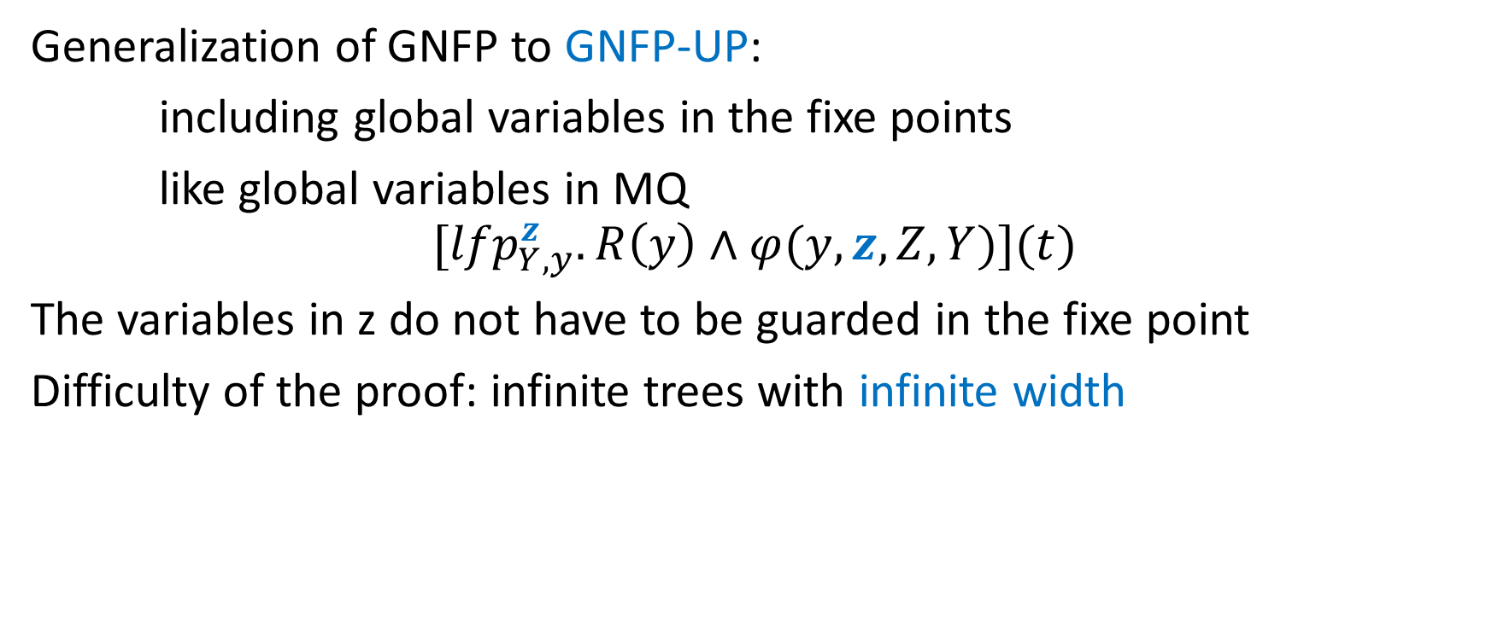
Generalization to Logics
Generalization of GNFP to GNFP-UP:
including global variables in the fixe points
like global variables in MQ
$$[{lfp}_{Y,y}^{z}. R\left(y\right)∧φ(y,z,Z,Y)](t)$$
The variables in z do not have to be guarded in the fixe point
Difficulty of the proof: infinite trees with infinite width
Satisfiability of GNFP-UP is k+2 exptime,
k = nesting of global variables

Slide 40
Other uses of automata for boundness
Sketch of proof:
Reducing to a problem for cost tree automata :
problem infinite limitedness theorem” (ILT) from Colcombet
Rewritability in FO of a fixpoint in GNFP-UP is decidable

Slide 41
Summarize
Inclusion of Queries is a core question for optimization
Undecidable for Datalog
Decidable for a huge range of queries MQ/GQ k+2 Exptime-c
Certain query Answering for a query
Undecidable for TGD
Decidable for frontier-guarded TGDs 2 Exptime-c
Generalization to logic GNFP-UP
Satisfiability of GNFP-UP k+2 Exptime-c
Proof based on bounded treewidth structures

Slide 42
To go further
A step up in expressiveness of decidable fixepoint logics
M. Benedikt, P. Bourhis, M. Vanden Boom LICS 2016
Query answering with transitive and linear-ordered data
A. Amarilli, M. Benedikt, P. Bourhis, M. Vanden Boom IJCAI 2016
Reasonable Highly Expressive Query Languages
P. Bourhis, M. Krötzsch, S. Rudolph IJCAI 2015
Monadic Datalog Containment
Michael Benedikt, P. Bourhis, P. Senellart ICALP 2015

Slide 43
Futur Work
Find some classes with lower complexities
Work on the rewriting in FO
Finding the tight bounds
Finding effective algorithm to find the FO formula

Slide 44

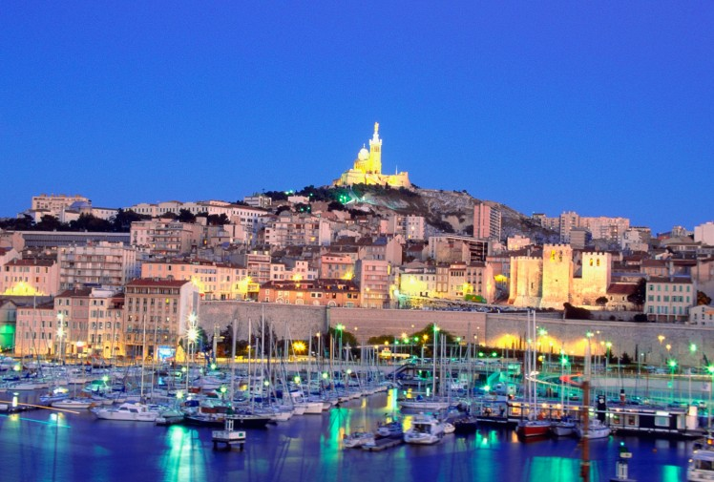
Des Questions ?
Merci !

